Slide 1
CodeU
Bootcamp
Welcome to your 1st session!
The class will start shortly...
Reproduction and distribution of the presentation deck is prohibited

Slide 2
Agenda for today’s class
Introduction
01
02
Fun facts and Kahoot!
Let’s go around the class and get to know each other!
To understand what is coding!
Topic of the day:
03
04
Practice time!
Learn to code like a pro!
Fun facts
Our first code!
Wrap-up
Conclusion
05
06
CodeU Robot
Summary of what we’ve learned today
homework and questions

Slide 3
Introduction
01
02
Hi! Who am I?
How about you?
I will be your teacher for this Bootcamp!
What is your name, how old are you, and what do you do in your free time?

Slide 4
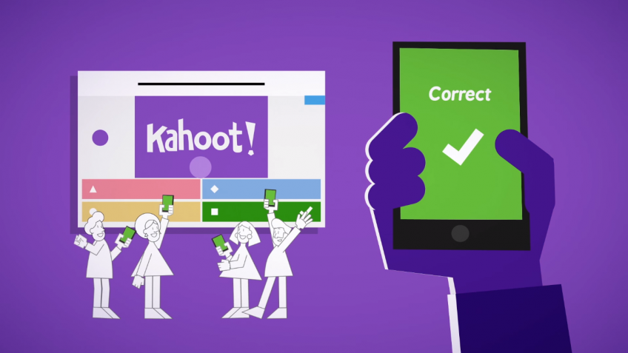
Time for Kahoot!
Head over to Kahoot.it for a fun coding quiz!

Slide 5



What is Programming?
Think of a chore you have to do at home
Like taking out the trash
You have set of rules to follow
Emptying the trash
Putting new bag in
Putting the trash in the bin
Creating a set of instructions that tell a computer how to perform a task.
You might run into obstacles
What happens if you don’t have anymore garbage bags?
Your human brain is able to find a solution, like going to the store to buy new ones.
But computers don’t have the same capabilities, you need to provide the exact instructions and conditions to solve different situations.

Slide 6
What are Programming Languages?
Definition
Application in the world
Language used to write instructions for the computer.
There are many languages used for every type of task
Zoo keepers
Video games
iPads
Traffic lights
Each language has different rules, syntax and structures, just like French and English
Ex: Binary code
100011001
110000011
100010000
2 types:
Low-level languages
Easy for the computer to read, but very hard for humans.
High-level languages
Use English and mathematical symbols to communicate instructions.
Ex: Python
print (“Hello World”)

Slide 7





Fun Facts!
Check out these cool examples!
Web developer
Did you know?
Play around and have some fun on the website!
Writing code to design websites
You need to know programming to be an astronaut!
Video game developer
Creating and editing video games
But that is not the only career opportunity you get with programming!
Cybercrime investigator
Investigate cybercrimes and track hacks

Slide 8




Fun facts!
Did you know?
The first programmer was a woman named Ada Lovelace!
She wrote the first algorithm designed for a computer.
There were many other significant women in the programming world such as Grace Hopper who was a pioneer in the engineering of the first computer.
The both showed resilience and ingenuity. Which are a few of the important characteristics any programmer should have.
Resilience
Creativity
The patience and passion to create a code
Solving problems by thinking outside the box
Ingenuity
Lifelong Learner
The ability to handle a problem in a logical, analytical way
Always willing to learn new things

Slide 9
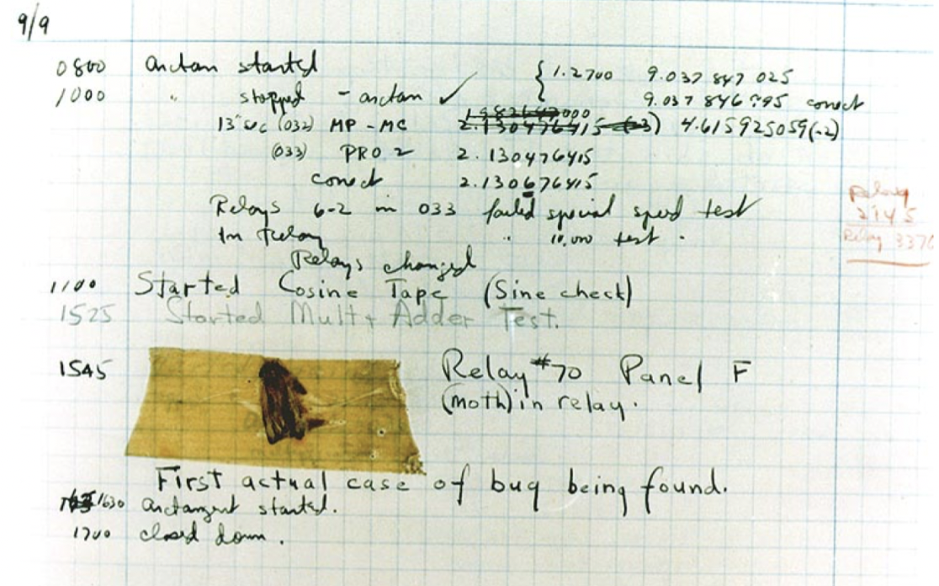
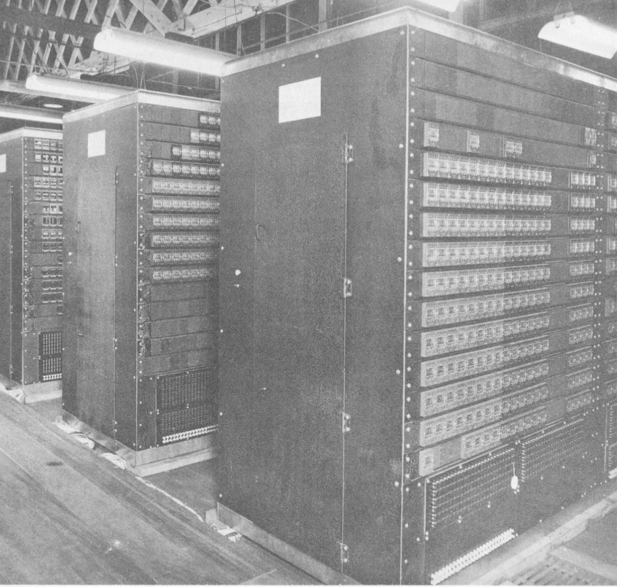

Fun Facts!
Did you know?
The first computer bug was an actual bug!
On September 9, 1947, the computer at the Harvard Laboratory started to malfunction. The error was due to a moth trapped inside the gigantic computer!

Slide 10
Your first code!
01
04
Type in the following:
Creating a variable
print(“Hello World!”)
A variable is a container that stores a value.
02
Example
name = ‘Jack’
Run the program
To run the program in a code editor, …
05
Comments
03
What do you see displayed?
Comments are used to annotate your code and to write down notes that you want the interpreter to ignore
Note that the quotation marks are not included.
Ex: #this comment will be ignored

Slide 11
Conclusion
Wrap-up
what is computer programming? | Creating a set of instructions for ____?
programming in our lives | What is an example of an object that uses programming?
first video game | What was the name of the first ever video game?
programming languages | What language did we use today?
fun facts | What is the type of bug that stayed trapped in the computer?
your first code! | What did our first code print?
variable? | What is a variable?

Slide 12




Thank you!
Does anyone have any questions?
Next Class: Class 2
Please contact us if you have any questions or if you want to notify us for anything.
Phone:
(438) 391-9106
Email:
hello@codeu.ca

